Slide 1
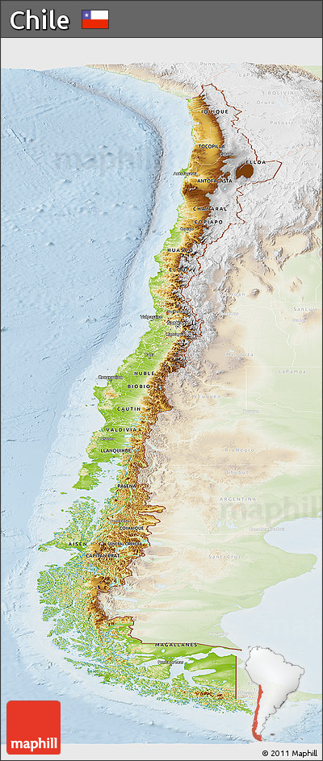
This physical map of Chile shows the variety in terrain and land features of this South American country. The shape of the country is long and lean, bordering the southern Pacific Ocean. Coastal areas are flat and filled with many inlets and peninsulas. The inner regions of the country are very mountainous. The mountain chain stretches nearly throughout the entire country. The locator map at the bottom of the map shows the relative location of Chile within the continent of South America.
Chile-Physical map

Slide 2
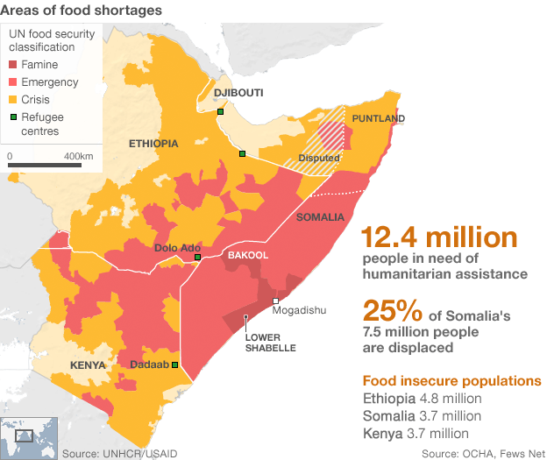
This thematic map of Somalia shows the desperate condition of large numbers of citizens due to extreme food shortage.
The map shows levels in crisis, emergency, and famine. Famine is a term that means widespread starvation and death due to lack of nutrition. The map shows a small area near Mogadishu that is classified as famine. Most concerning, however is the large area surrounding Mogadishu that is in the emergency category. This means that food shortage and starvation are near famine levels. This is an important map because it shows the percent of Somalians that have been displaced due to war and are struggling to grow or find food.
Somalia- Food Shortage Thematic Map

Slide 3
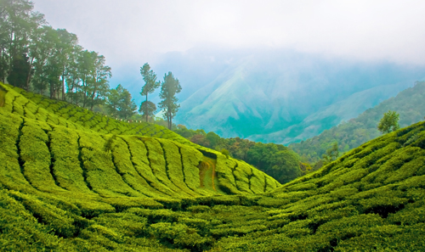
The land in India is extremely varied, and it is interesting to note that India contains every possible physical feature including tall mountains, deep valleys, expansive plains, Plateaus ,coastal ghats, desert and a number of islands.. The Great Himalayan Mountains are located in the northern region of the country, and they contain the world’s 3rd tallest peak, Kanchenjungha. The Deccan Plateau is a long stretch of elevated flatland that is a recognizable feature of India. in addition to fertile plains for farming. Much of India is lush farmland fertile for growing rice, wheat, tea and coffee.
INDIAS LAND AND PHYSICAL FEATURES

Slide 4
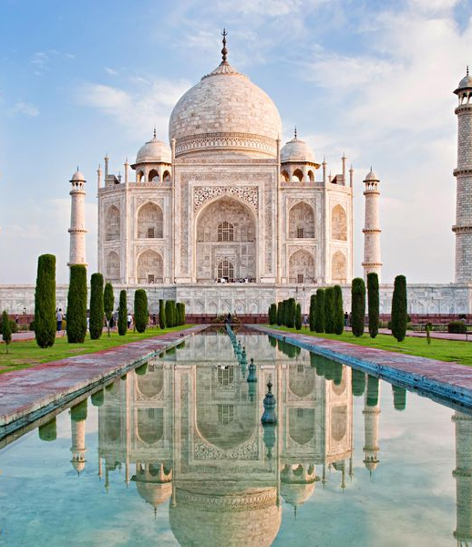
The Taj Mahal….
The Taj Mahal is undeniably the most recognizable feature in India. It is estimated that three million people visit the site each year. Built as a mausoleum for the wife of a famous emperor in the 1600s, The Taj Mahal includes a tomb, a mosque, gardens, and outer buildings. It is recorded as one of the eight wonders of the world. The unique architecture and materials that were used in creating the Taj Mahal make it celebrated as one of the most amazing human achievements of all time.

Slide 5
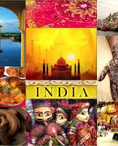
CULTURE IN INDIA
Every caste, tribe, town, village, and religion has their own unique ceremonies, festivals, and traditions. Most Indian events are linked to some sort of religious belief or deity. Meditation and connecting the soul to the universe are trademarks of Indian culture. Yoga originated in India, and is the oldest known version of meditation. Indians celebrate important occasions with gifts and offerings of flowers, spices and prepared meals to loved ones and Hindu Gods and Goddesses.
Spices and flavor vary by local region, but Indian food is know to be flavorful and aromatic. Rice is a staple for most Indian families, and many Indians maintain a vegetarian diet. In general, the Indian culture emphasizes a great respect for the natural world and for family members.

Slide 6
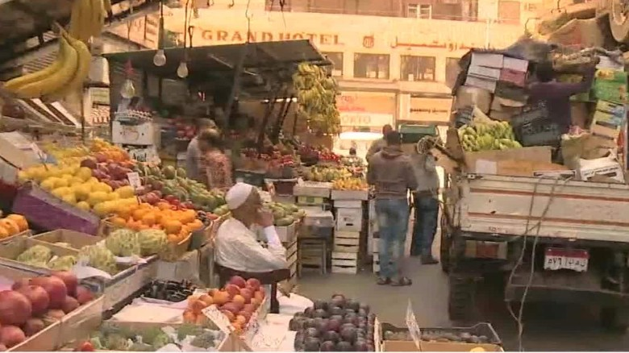
Egypt’s economy has undergone many changes in the past decade… A major shift in government and economic policies has created an uncertain global market, however Egypt has many factors that work in favor of economic growth. The country is a member of many international organizations that support fair trade and economic policies.
Egypt is located in the center of the Middle East and therefore has a strategic location for trade and business with the rest of the world. Most economic activity in the country has historically taken place along the Nile River as an important source of transportation of goods.
Main exports - Oil, Petroleum, Chemicals, and Metal. The United States, Italy, Germany and other European countries are major export partners.
Main Imports- Food, Equipment and Machinery, and Wood-
Most important import partner is the United States

Slide 7
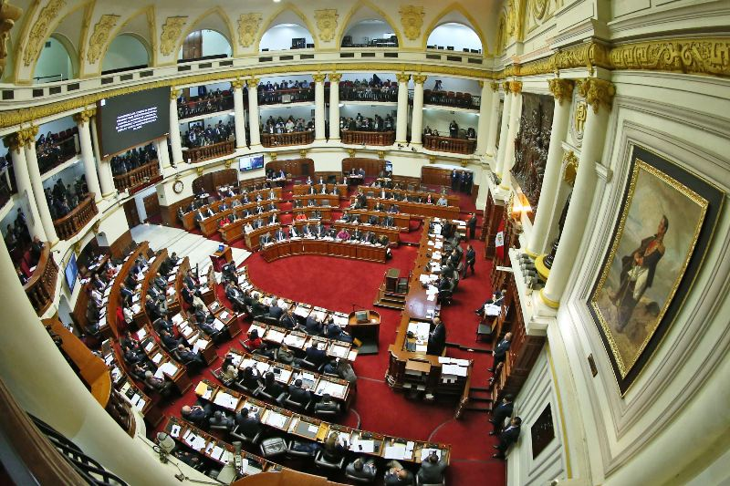
The government of Peru is lead by a President who is elected by the citizens. The government is officially a Presidential Republic, and all citizens are required by law to vote. There are many political parties that make up the unicameral congress. Peru also has a Supreme Court to make sure that all laws passed by Congress are being used fairly.

Slide 8
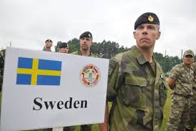
CAUSE-
Recent changes in political climate have prompted Swedish leaders to reinstitute mandatory military participation called conscription. Similar to a draft, this process carefully screens men and women within a designated age category to determine eligibility for serving in the Swedish Military.
The Russian illegal annexation of Crimea ,the conflict in Ukraine and the increased threat of nuclear weapons from North Korea are placing pressure on Sweden to provide a more consistent source of military support. Volunteer membership in the armed forces in Sweden could not provide the number of recruits needed for heightened security purposes.
Military Conscription in Sweden- January 2018

Slide 9
Military Conscription in Sweden- January 2018
Effect
The effect of the recent change to a conscripted military in Sweden may have a domino effect for other nations in Europe and worldwide. The growing tensions around the world are creating a more desperate need for defense that can not always be filled with volunteers. The long term negative effects of drafting members to military service can include decreased levels of graduates of higher degrees, decreased wages and contributions to the local economy, and increased levels of post traumatic stress disorders and mental illness. Military conscription is controversial, and Sweden is setting the stage for new struggles over mandatory service…
http://www.bbc.com/news/world-europe-39140100
https://www.independent.co.uk/news/world/europe/sweden-military-conscription-draft-russia-balkan-threat-men-women-a7607411.html
https://www.theatlantic.com/international/archive/2017/03/sweden-conscription/518571/

Slide 10
In Argentina, children are often the focus of the family. In middle and upper class families children are expected to be successful in school, and families sacrifice time and money for the opportunity for children to earn an education. Young adults typically live with their family well into adulthood, as housing can be expensive.
The roles of men and women within the family are changing, but traditionally men in Argentina work long hours into the evening to support their family, while women tend to manage household tasks and childcare.
Equal pay and opportunity for women in the workforce remains a problem for Argentinians, and violence against women is also a major concern.
The lifestyle and expected roles of individuals in Argentina varies depending on whether the family lives in an urban or rural area.
FAMILY
Public schools in Argentina are free, and attendance is required, though quality education varies greatly by location. Public school teachers are underpaid and often attendance at public schools can be inconsistent due to teacher work strikes. Private or subsidized (partially funded) schools are more reliable, and are attended by middle and upper class families. Some families living in rural areas cannot afford to send their children to school, as they require their help working in the fields.
EDUCATION

Slide 11
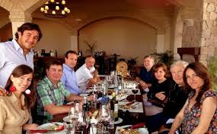
NORMS
Close personal space is considered normal
Eye contact or hands on your hips can be considered confrontational
Hand gestures are an important part of conversations
Individuals are introduced using titles
Mate is an herbal tea that is shared among friends or family members
Dinner is often served late in the evening- around 9:00 pm when everyone is home from school and work

Slide 12
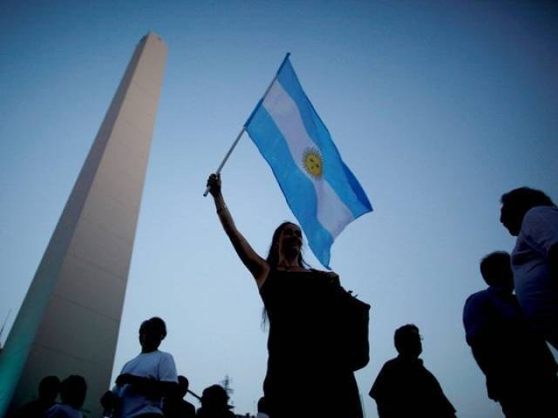
Argentina has recently become a country that relies on service industries more than agriculture, though livestock and animal wool, hides and beef are still important contributions to the GDP. The economy of Argentina has been inconsistent in recent decades, and has been vulnerable to inflation and global trends towards recession. Unemployment levels are high in Argentina, and government controls of resources and jobs often make economic problems worse. Literacy rates and life expectancy are lower than most developed countries. The value of Argentinian currency is weak, and many citizens struggle to save money for future use. Argentina’s GDP was $12,709 per capita in 2017, which places them 58th in the ranking of 196 countries worldwide.
Economy

Slide 13
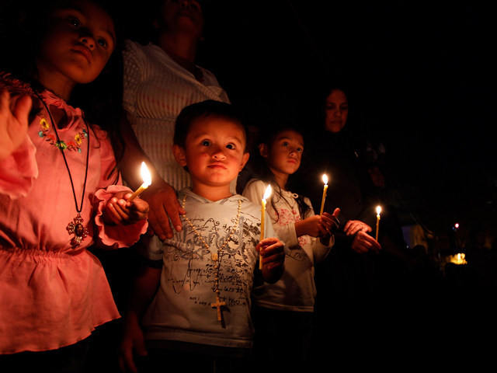
The Catholic church is a major influence in the lives of Argentinian people. 92% of the population are Roman Catholics. Even though the church as an institution has significant influence over social norms and traditions, it is not common for Argentina’s citizens to attend church regularly.
The country has a specified separation of church and state, and freedom to practice and worship in any faith is granted in this country.
RELIGION

